Slide 1

Python Machine Learning: EDA
Žydrūnė Kelpšaitė
Data Analyst

Slide 2
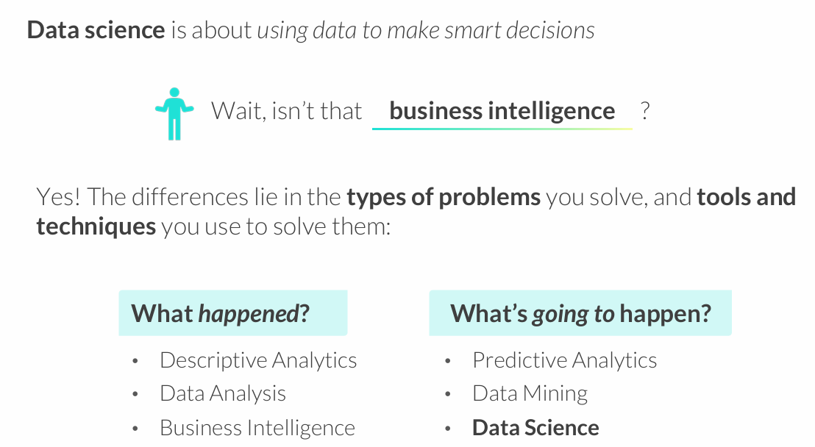
WHAT IS DATA SCIENCE?

Slide 3
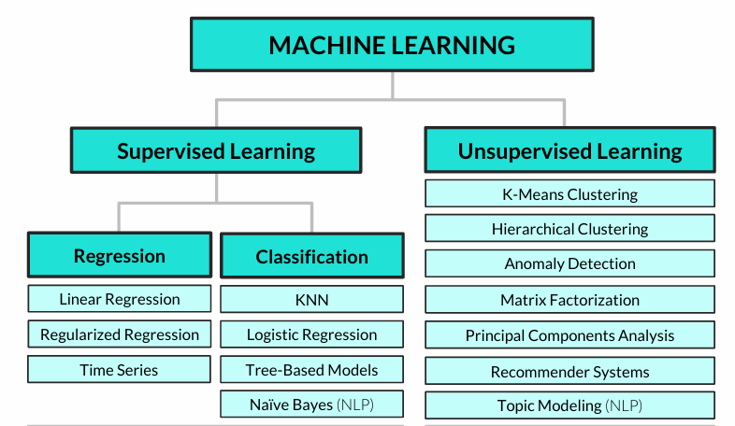
Common machine learning algorithms

Slide 4
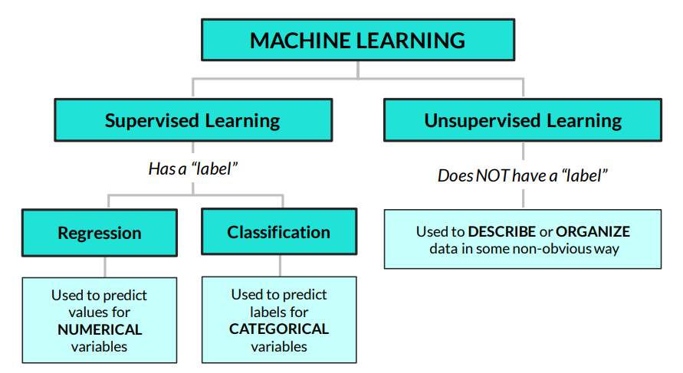
UNSUPERVISED LEARNING 101
Unsupervised learning is about finding insights & patterns hidden in the data
• Unlike regression or classification, we don’t care about splitting our data into train / test sets and making predictions, we just care about understanding the relationships in our data

Slide 5
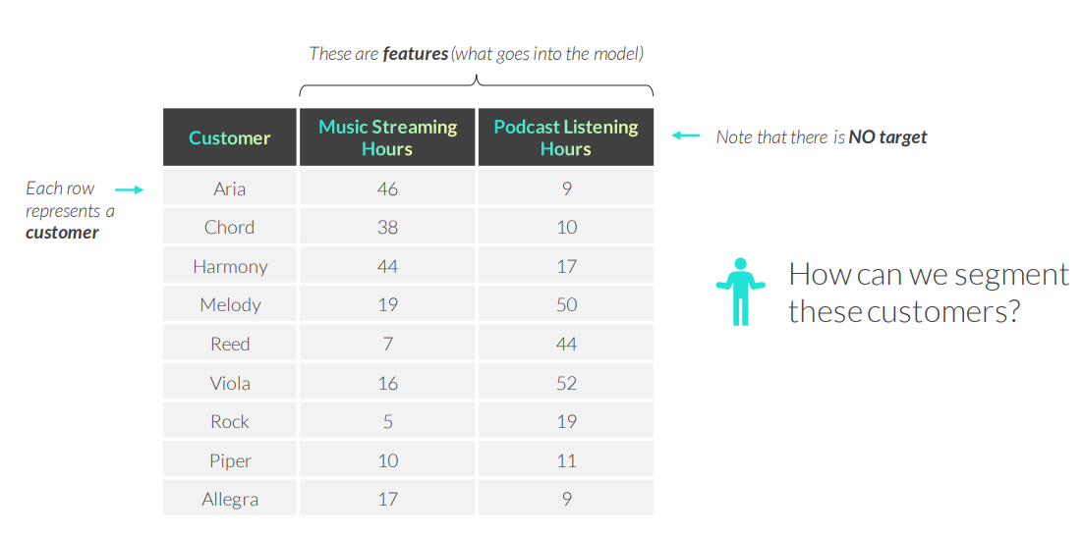
UNSUPERVISED LEARNING 101
EXAMPLE Clustering customers based on listening behavior

Slide 6
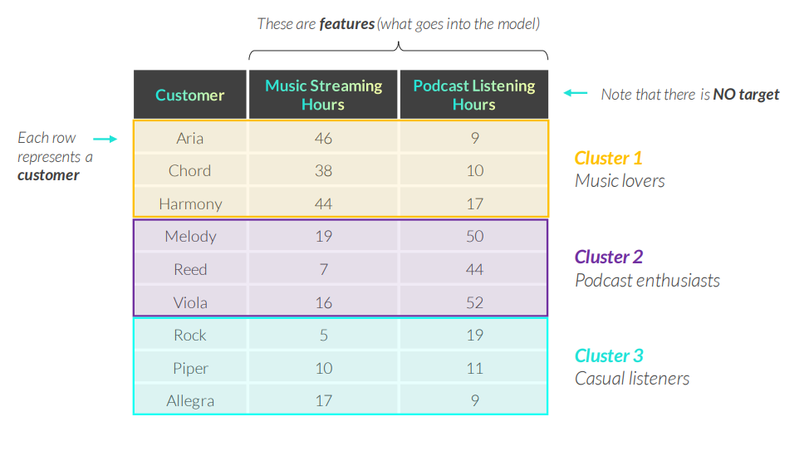
UNSUPERVISED LEARNING 101
EXAMPLE Clustering customers based on listening behavior

Slide 7
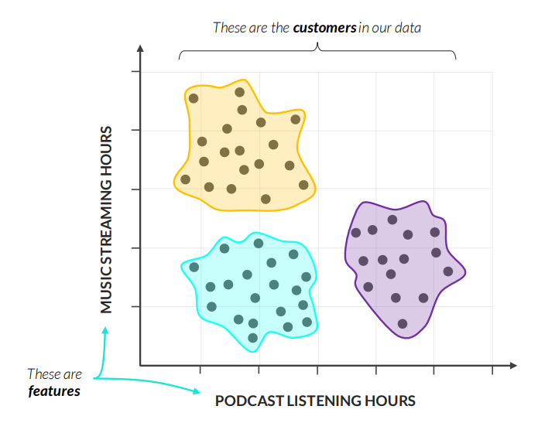
UNSUPERVISED LEARNING 101
EXAMPLE Clustering customers based on listening behavior
We can clearly segment our customers into three clusters:
• Music lovers
• Podcast enthusiasts
• Casual listeners

Slide 8
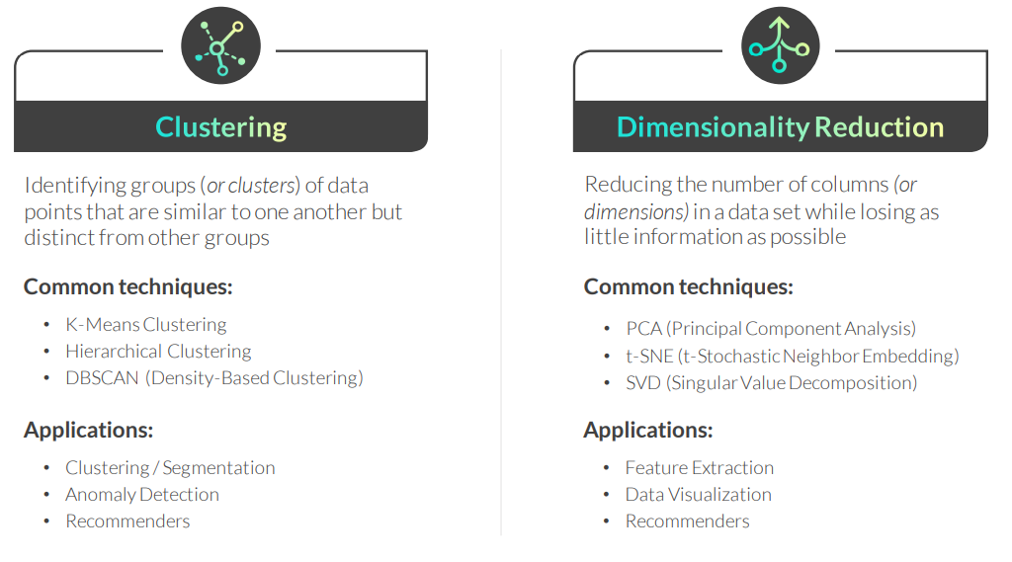
UNSUPERVISED LEARNING TECHNIQUES
There are two popular categories of unsupervised learning techniques:

Slide 9
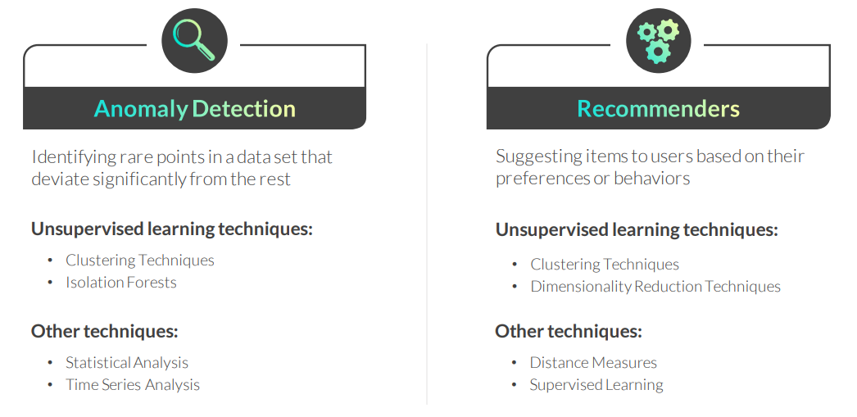
UNSUPERVISED LEARNING APPLICATIONS
These are two common applications of unsupervised learning techniques:

Slide 10
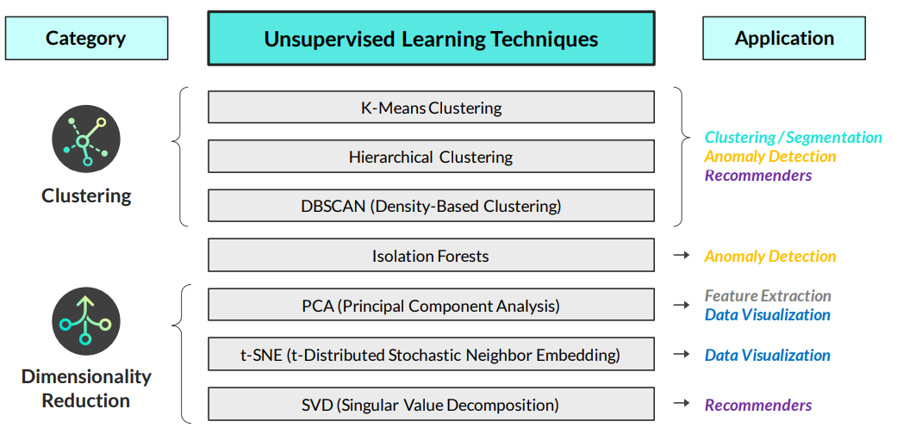
Unsupervised learning techniques & applications

Slide 11
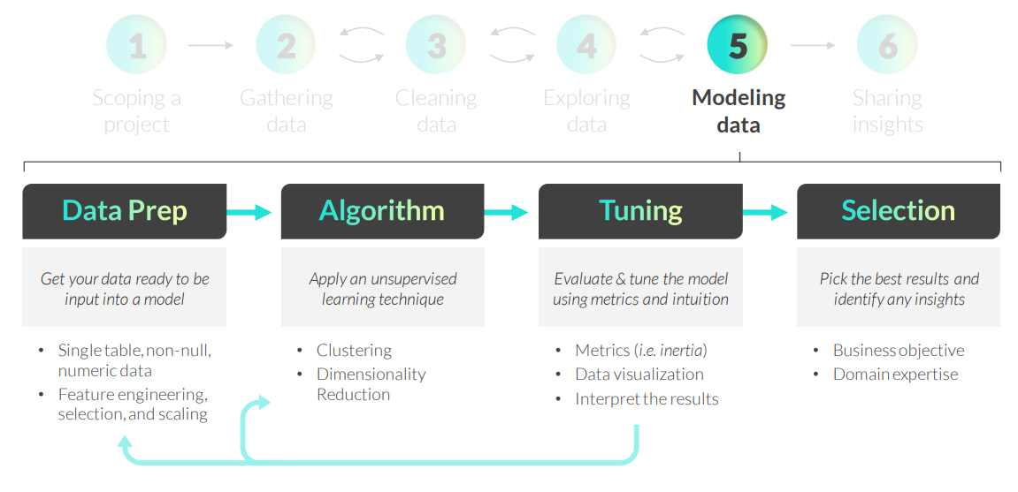
UNSUPERVISED LEARNING WORKFLOW
The main differences compared to supervised learning are the lack of data splitting (having training and test sets) and the focus on evaluation based on intuition (versus mainly metrics)

Slide 12
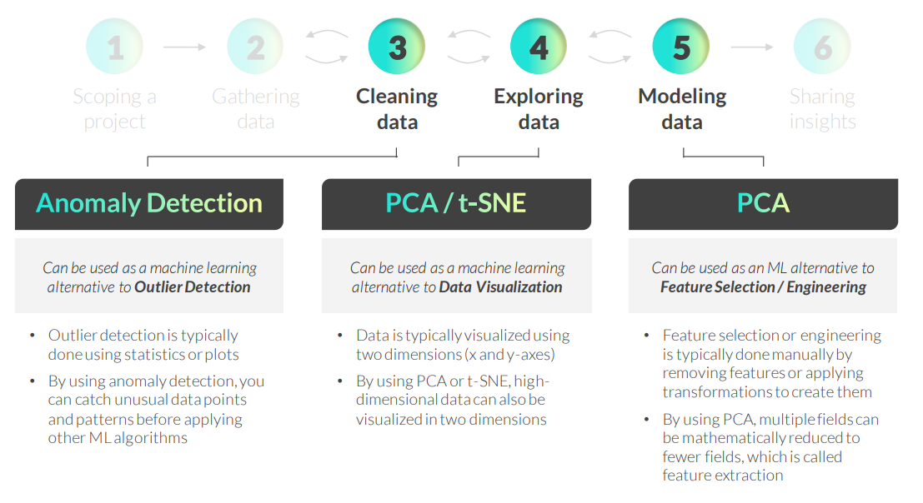
UNSUPERVISED LEARNING WORKFLOW

Slide 13
KEY TAKEAWAYS
Unsupervised learning is used to find patterns & relationships in data
• There are no predictions or labels with unsupervised learning – we are just trying to better understand the data’s non-obvious structure, organization, and relationships between data points
Unsupervised learning has a different mindset than supervised learning
• Unlike supervised learning, unsupervised learning does not require splitting the data into a training and test set, and the evaluation is based on a heavy-dose of domain expertise in addition to metrics
There are multiple applications for unsupervised learning techniques
• While the two main categories of unsupervised learning techniques fall under clustering and dimensionality reduction, these techniques can be applied to segmentation, anomaly detection, recommenders, and more
The techniques can be used at multiple steps of the data science workflow
• In addition to using unsupervised learning techniques during the modeling step of the data science workflow, select techniques can also be used during the data cleaning, exploration, and feature engineering phases

Slide 14
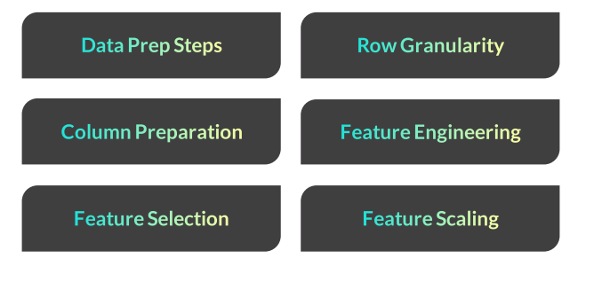
PRE-MODELING DATA PREP

Slide 15
PRE-MODELING DATA PREP
Common data prep steps required to transform source data into a format that can be directly input into an unsupervised learning model:
Setting the correct row granularity
Ensuring each column is non-null and numeric
Engineering features for modeling
Selecting features and excluding identifier columns
Scaling features for distance-based unsupervised learning algorithms

Slide 16
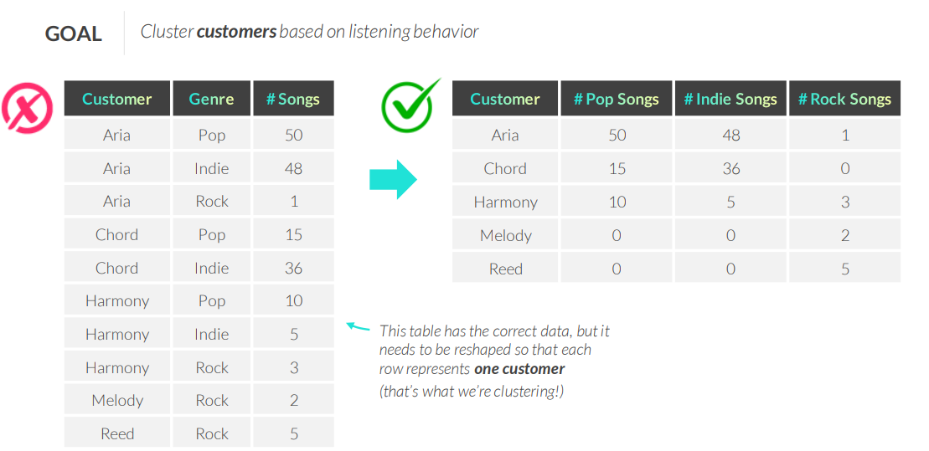
SETTING THE CORRECT ROW GRANULARITY
To set the correct row granularity, think about the question you’re trying to answer and determine what one row (observation)of your table will look like

Slide 17
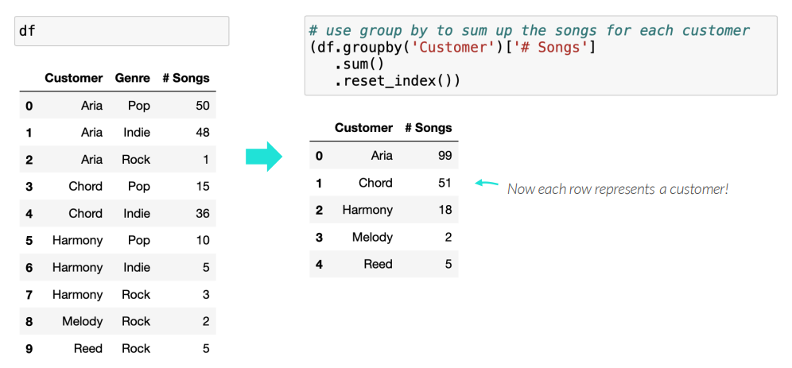
RESHAPING DATA
Common ways to reshape data to the correct row granularity are:
• Using .groupby() to combine all records with the same ID column into a single row

Slide 18
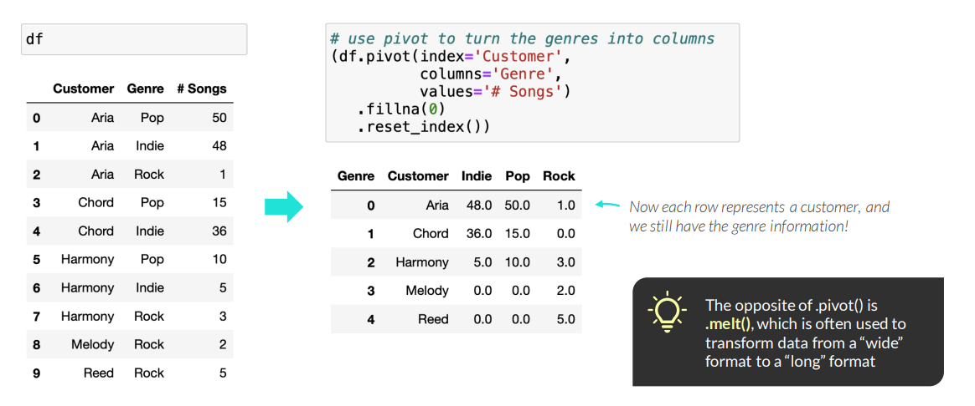
RESHAPING DATA
Common ways to reshape data to the correct row granularity are:
• Using .groupby() to combine all records with the same ID column into a single row
• Using .pivot() to transform data from a “long” format to a “wide” format
Notes:
pd.melt(df,
id_vars="Customer",
value_vars=["Pop","Rock","Indie"],
var_name="Genre",
value_name="Songs")

Slide 19
PREPARING COLUMNS FOR MODELING
After setting the row granularity, you need to prepare your columns for modeling:
All values should be non-null
• Identify missing (or null) values using df.info() or df.isna()
• Resolve them by either removing them or imputing the values
All values should be numeric
• Convert fields from text data types to numeric data types
• Turn fields into numeric fields using conditional logic with np.where()
• Turn categorical fields into numeric fields using dummy variables
PRO TIP: There are some algorithms that can handle null and non-numeric values, including treebased models and some classification models, but it’s still best practice to prepare the data this way

Slide 20
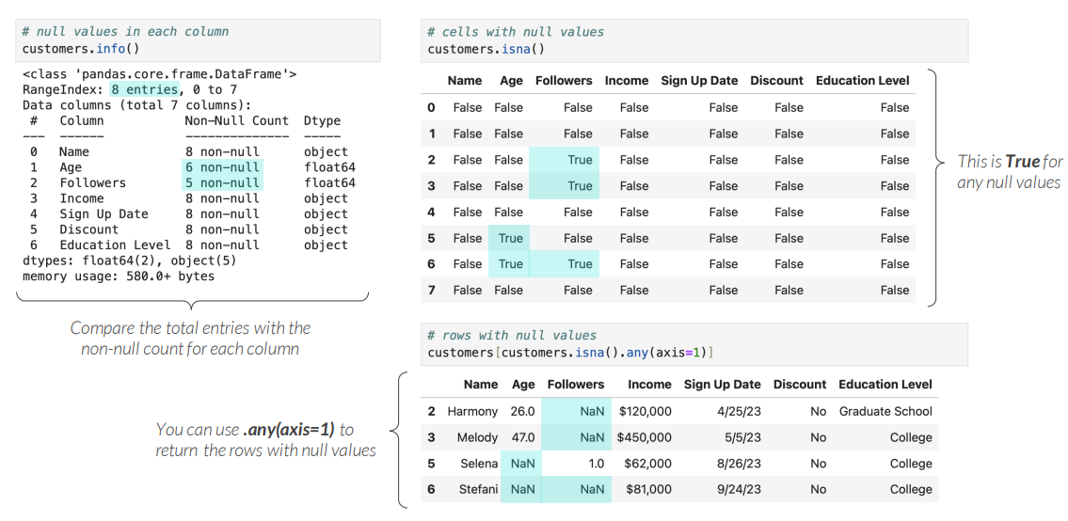
IDENTIFYING MISSING DATA
You can identify missing data with the .info() or .isna() methods

Slide 21
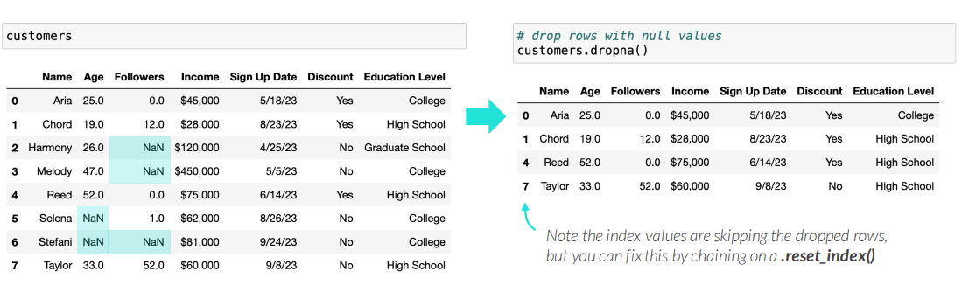
HANDLING MISSING DATA
There are multiple ways to handle missing data in a DataFrame:
• The .dropna() method removes rows or columns with missing data
PRO TIP: The .dropna() method defaults to dropping rows, but you can drop columns instead by specifying .dropna(axis=1)

Slide 22
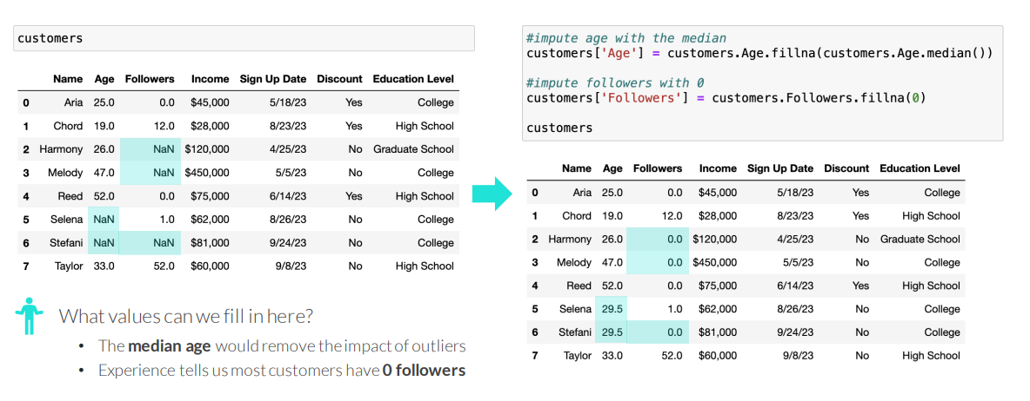
HANDLING MISSING DATA
There are multiple ways to handle missing data in a DataFrame:
• The .dropna() method removes rows or columns with missing data
• The .fillna() method imputes missing data with an appropriate value

Slide 23
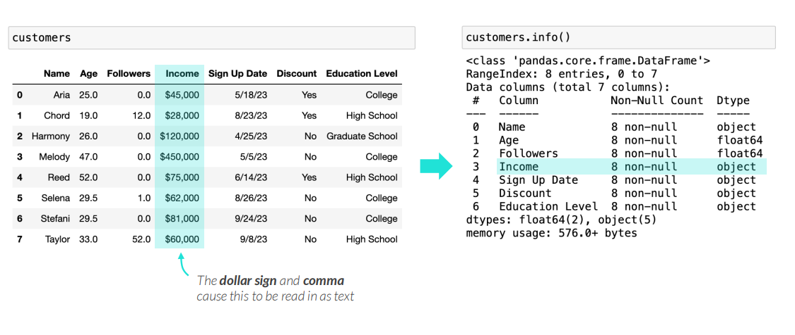
CONVERTING TO NUMERIC
Pandas will often read in numeric fields as text (object) data types
Use pd.to_numeric() to convert them to numeric fields

Slide 24
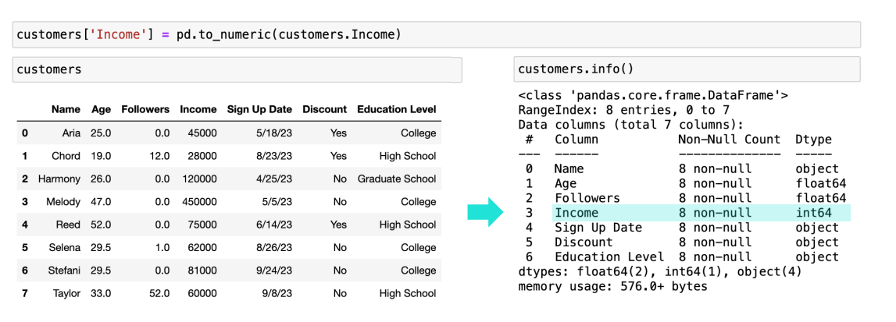
CONVERTING TO NUMERIC
Pandas will often read in numeric fields as text (object) data types
Use pd.to_numeric() to convert them to numeric fields

Slide 25
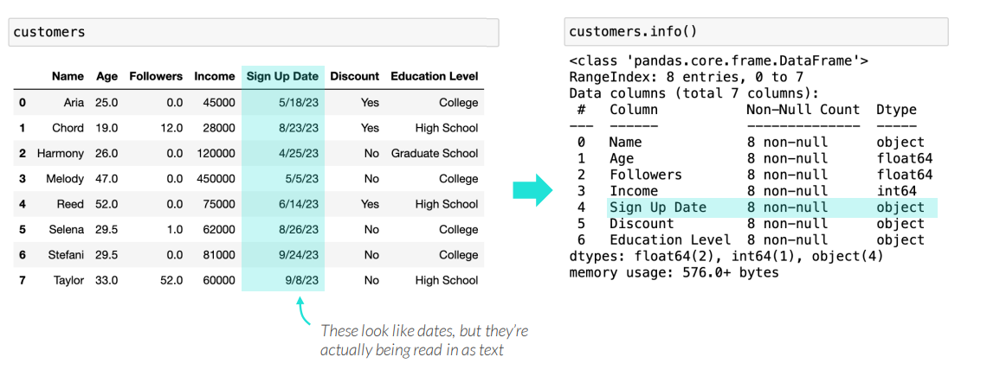
CONVERTING TO DATETIME
Pandas will often read in date fields as text (object) data types as well
Use pd.to_datetime() to convert them to datetime fields

Slide 26
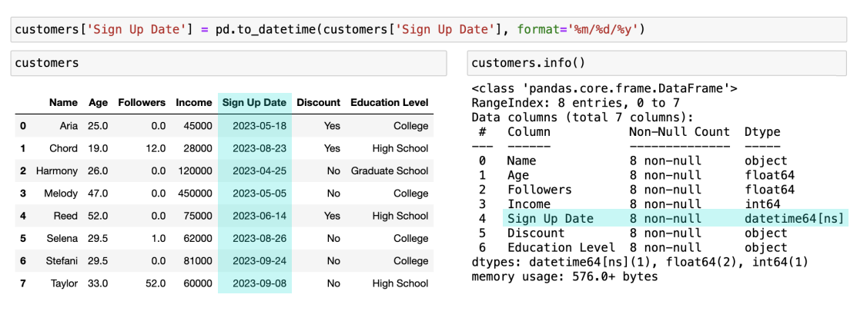
CONVERTING TO DATETIME
Pandas will often read in date fields as text (object) data types as well
Use pd.to_datetime() to convert them to datetime fields
While a datetime field can’t be input into a model, its components can be extracted as numeric values and saved as new fields for modeling

Slide 27
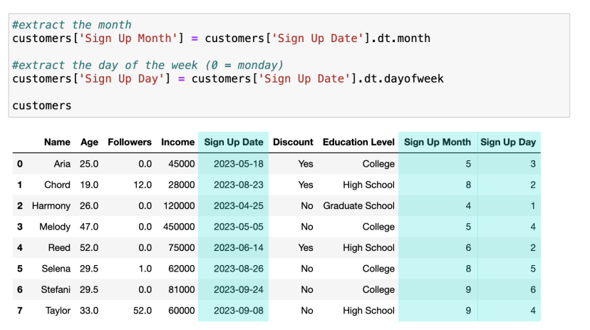
EXTRACTING DATETIME COMPONENTS
Use datetime methods to extract components from datetime fields
Even though month and day of week look like numeric values, it’s inaccurate to say that 8>5 (August is better than May). These values often go through an additional process called binning, in the feature engineering workflow section.

Slide 28
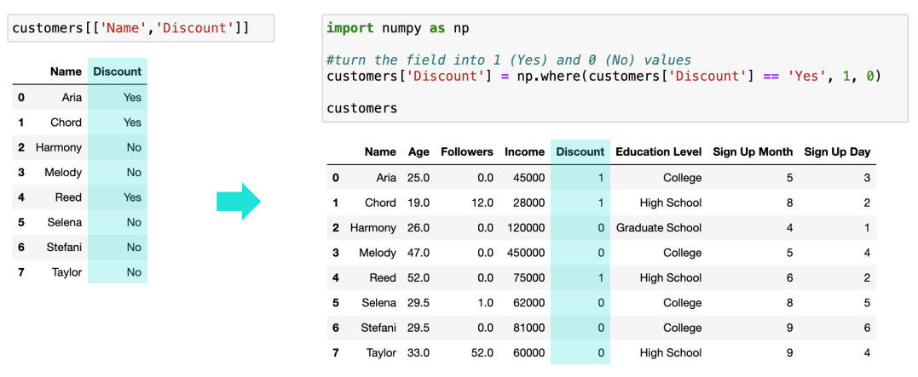
CALCULATING BASED ON A CONDITION
Use np.where() to create a numeric column based on a logical condition
PRO TIP: np.where() is quite versatile and can also be used to set values other than 1/0 (other numeric values, text values, etc.), set more than two values, set values for another column, and more

Slide 29
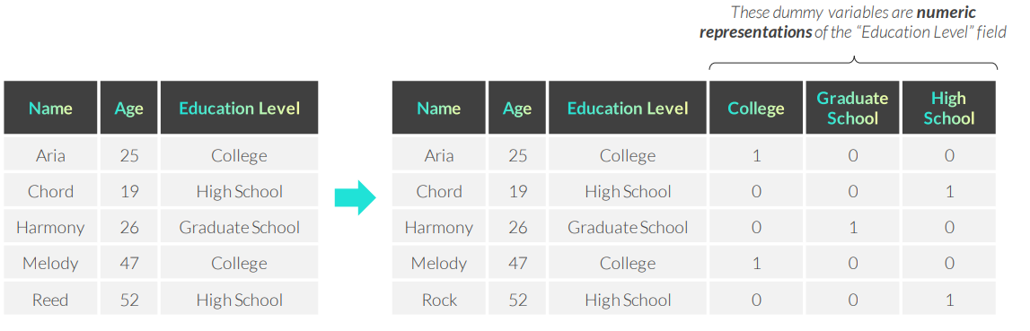
DUMMY VARIABLES
A dummy variable is a field that only contains ones and zeros to represent the presence (1) or absence (0) of a value, also known as one-hot encoding
• They are used to transform categorical fields into multiple numeric fields

Slide 30
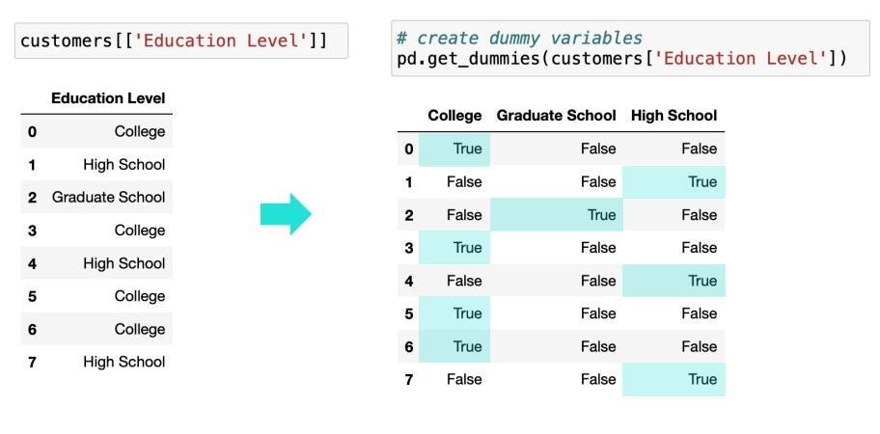
DUMMY VARIABLES
Use pd.get_dummies() to create dummy variables in Python

Slide 31
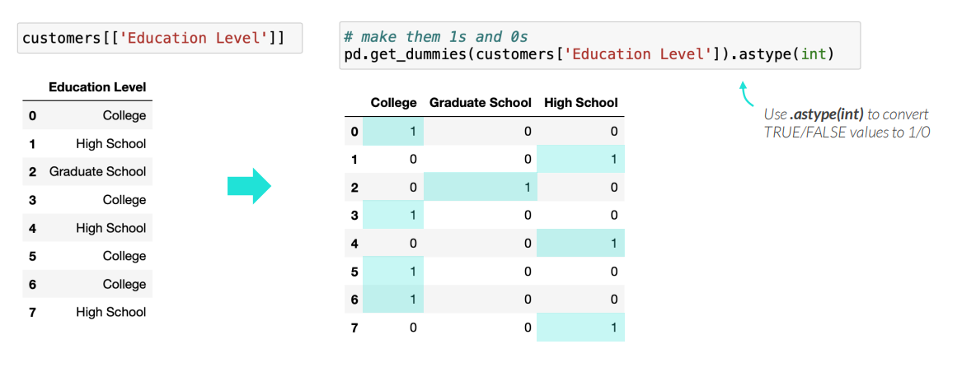
DUMMY VARIABLES
Use pd.get_dummies() to create dummy variables in Python

Slide 32
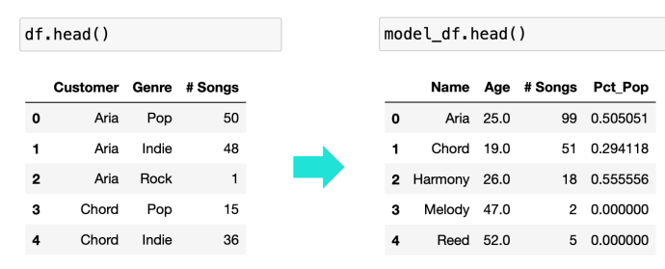
FEATURE ENGINEERING
Feature engineering is the process of creating columns that you think will be helpful inputs for improving a model (help segment, recommend, etc.)
This DataFrame:
• Is at the correct row granularity
• Contains non-null and numeric values
• Includes newly engineered features
• Is ready for modeling
Common feature engineering techniques:
• All the data prep steps so far
• Applying calculations
• Binning values
• Identifying proxy variables
Once you have prepared the rows & columns, the data is technically ready for modeling
However, being deliberate about engineering new features can be the difference between a good model and a great one

Slide 33
FEATURE ENGINEERING DURING DATA PREP
Everything we’ve done so far is technically a feature engineering technique, since we’ve created new columns, or features, along the way
Setting the correct row granularity
• Feature aggregation: aggregating multiple rows into a single row
2. Ensuring each column is non-null and numeric
• Handling missing data: imputing missing values
• Categorical encoding: turning categorical values into numeric values

Slide 34
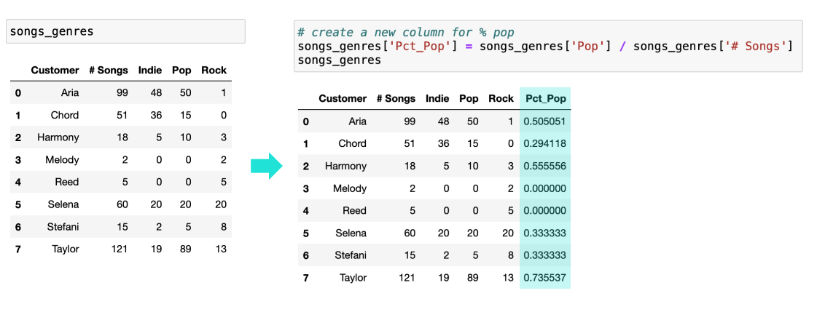
APPLYING CALCULATIONS
Combine columns using calculations to create new features

Slide 35
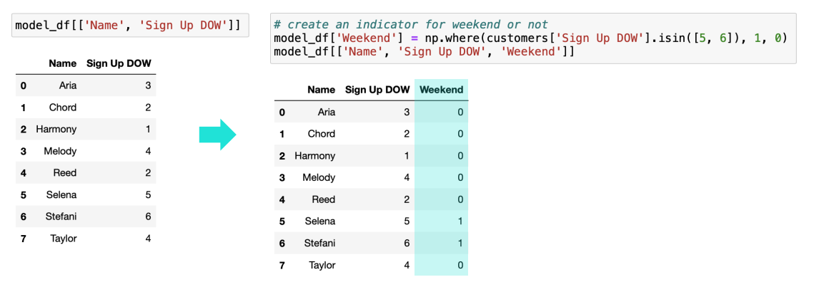
BINNING VALUES
Group numerical features into bins or discrete categories if it makes more sense for your analysis

Slide 36
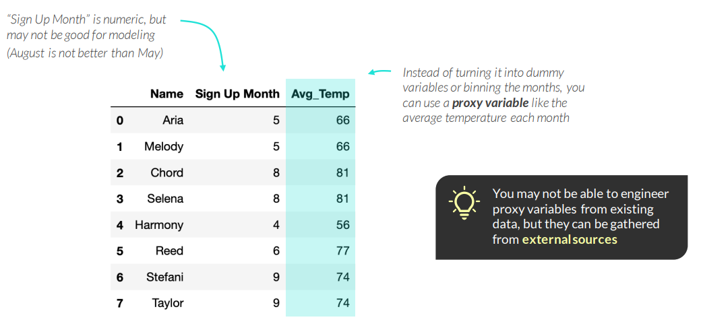
PROXY VARIABLES
A proxy variable is a feature meant to approximately represent another variable
• They are used when a feature is either difficult to gather or engineer into a new feature

Slide 37
FEATURE ENGINEERING TIPS
Anyone can apply an algorithm, but only someone with domain expertise can engineer relevant features, which is what makes a great model
2. You want your data to be long, not wide (many rows, few columns), so remember to:
• Try to collect as many observations (rows) of data as you can
• Only select the most meaningful features for modeling
3. Once you start modeling, you’re bound to find things you missed during data prep and will continue to engineer features

Slide 38
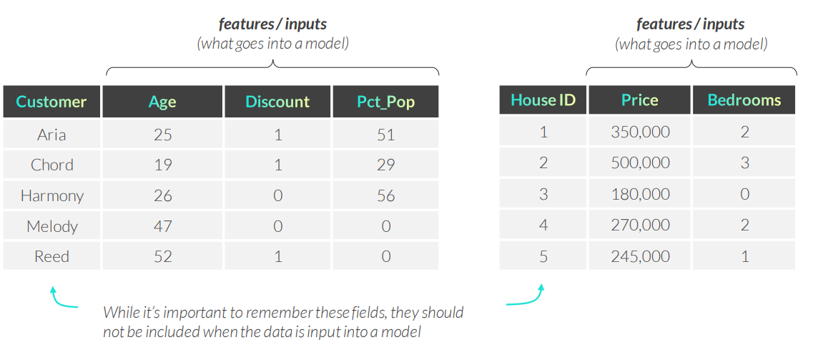
EXCLUDING IDENTIFIERS
Columns containing names or IDs should be excluded from modeling, but remembered for interpretation down the line

Slide 39
FEATURE SELECTION
More features does not always mean a better model, so it’s important to select a subset of the features for modeling
How do we select the “right” number of features?
• Use your intuition and think about the goal for your analysis – which features would do the best job predicting / segmenting / etc.?
• Start simple with perhaps two or three features for your model, then assess the results, and continue to make the model more complex and assess
• Don’t worry about getting this right the first time – modeling is a lot of trial and error!

Slide 40
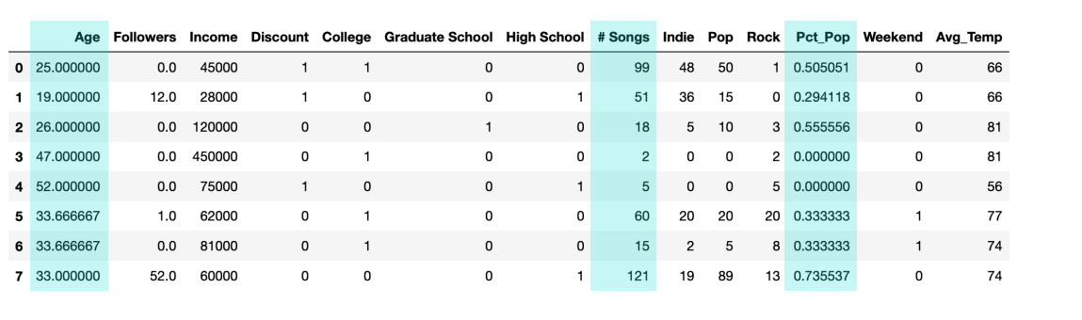
FEATURE SELECTION
More features does not always mean a better model, so it’s important to select a subset of the features for modeling
My domain expertise & gut feel is telling me that the best way to differentiate customers is by their age, the total number of songs they listen to and the types of songs they listen to.
These three features are what I’ll include in my first round of modeling

Slide 41
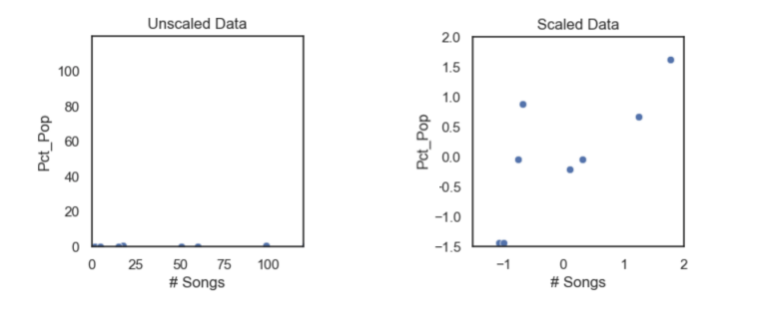
SCALING FEATURES
Scaling requires setting all input features on a similar scale
• Scaling is an optional feature engineering step which depends on the ML algorithm
• Common techniques for scaling include normalization and standardization
PRO TIP: Many unsupervised learning techniques use distance-based calculations, which makes scaling a required data prep step before modeling

Slide 42
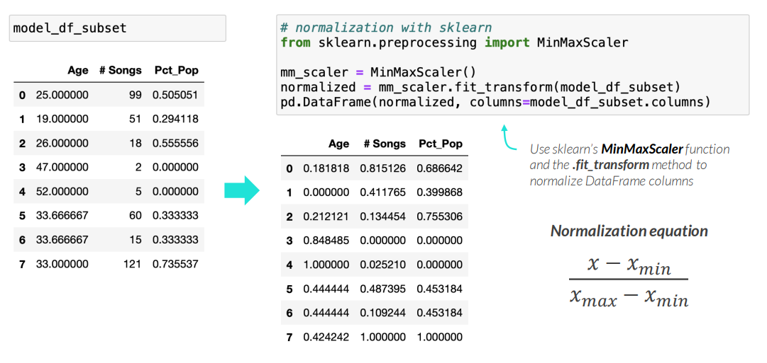
NORMALIZATION
Normalization transforms all columns to be between 0 and 1 (or between -1 and 1)
• This is typically used when the column distributions are unknown or mixed

Slide 43
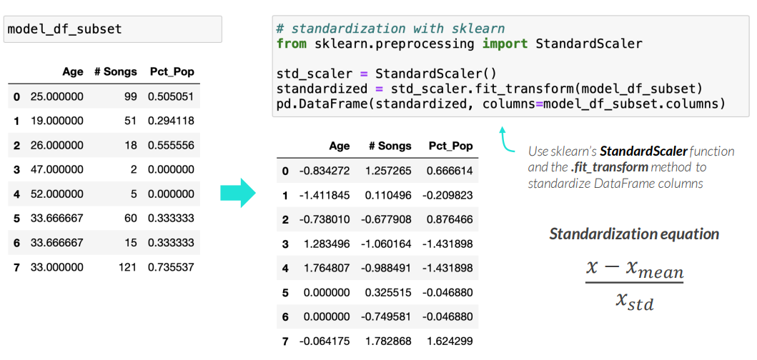
STANDARDIZATION
Standardization transforms all columns to have a mean of 0 and standard deviation of 1
• This is typically used when the column distributions are normal (bell curve)

Slide 44
KEY TAKEAWAYS
Data prep is required before applying unsupervised learning techniques
• This includes setting the correct row granularity, making sure all columns are non-null and numeric, engineering useful features, selecting the best ones, and scaling them
Both the rows & columns of a DataFrame must be prepared for modeling
• There are several techniques that are commonly used to prepare rows and columns for modeling, including using .groupby(), .pivot(), .fillna(), np.where() and pd.get_dummies()
Feature engineering can be the difference between a good and a great model
• There are many techniques for feature engineering, including aggregating values, handling missing data, categorical encoding, applying calculations, binning data, using proxy variables – and then selecting features
Feature scaling is required for models that use distance-based calculations
• Many unsupervised learning techniques use distance-based calculations, and it’s a good idea to try multiple scaling techniques, including normalization and standardization, to see which one performs best

